Slide 1
Client Deliverables
Movie Ratings
Advanced Visualization with GGPLOT2

Slide 2
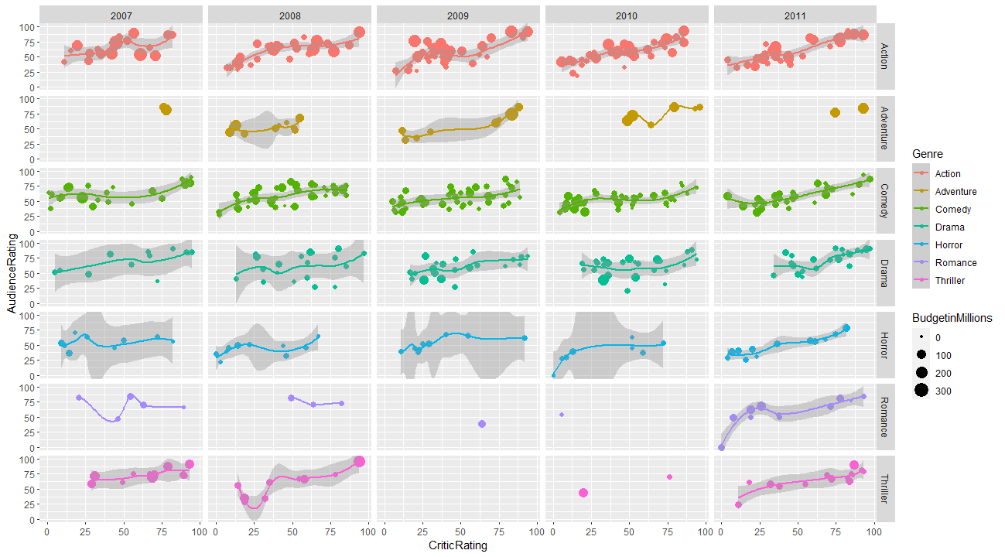
Comparison of critic ratings v/s audience ratings across genres across the years 2007 to 2011

Slide 3
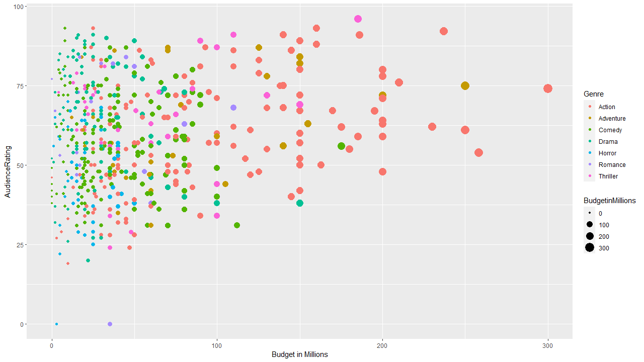
Correlation between audience rating and movie budget across genres

Slide 4
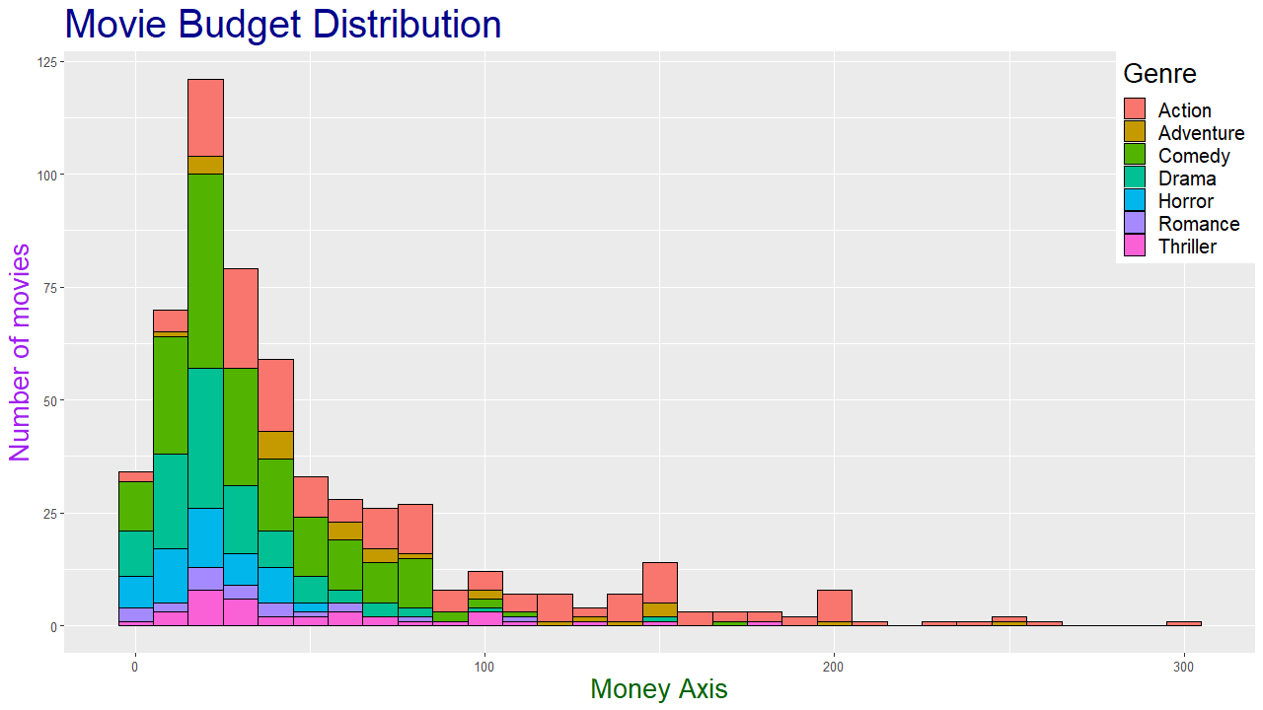
Comparing number of movies made per genre and their corresponding movie budgets

Slide 5
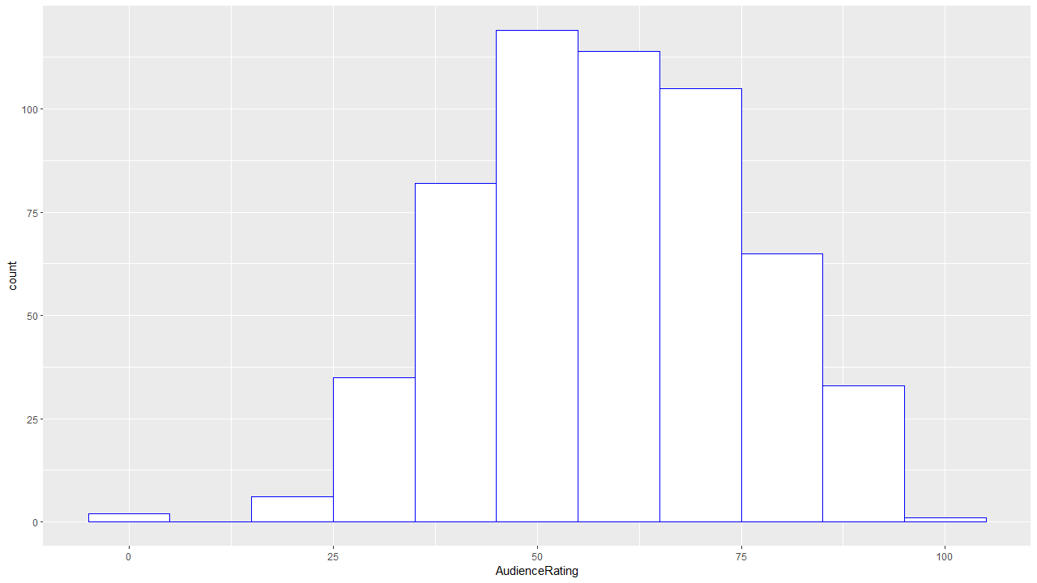

Slide 6
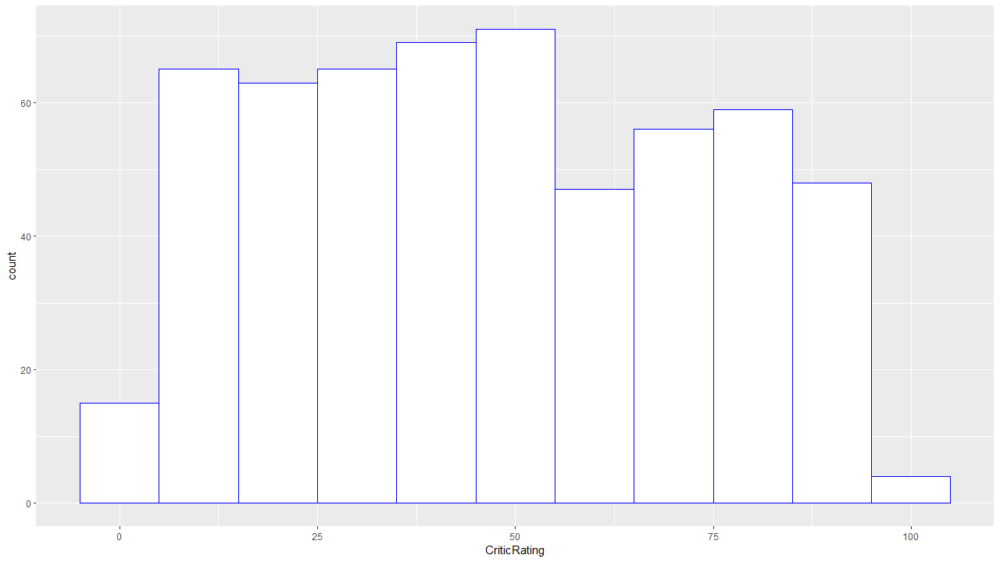

Slide 7
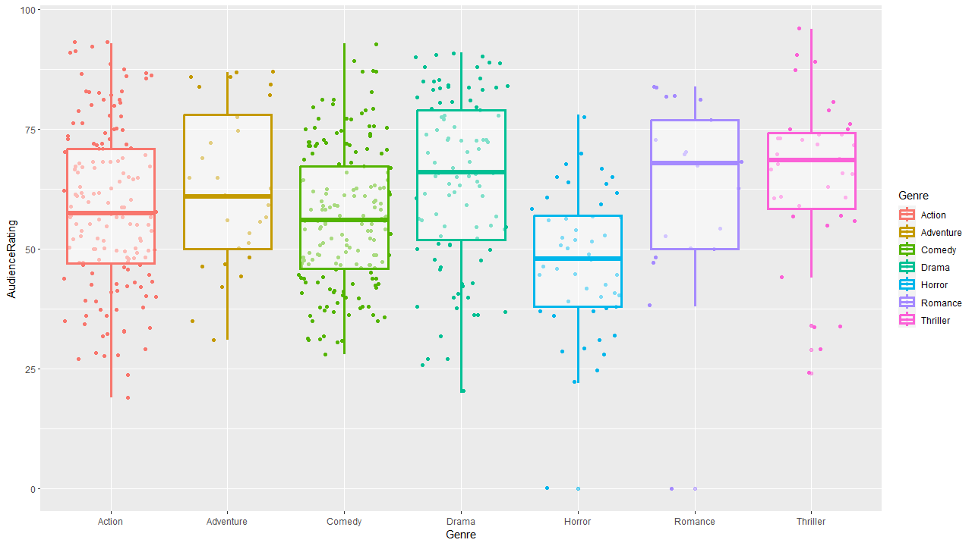
Boxplot showing correlation between movie genres and audience ratings

Slide 8
